Slide 1
Agree or disagree – “an eye for an eye, a life for a life.” Explain.

Slide 2
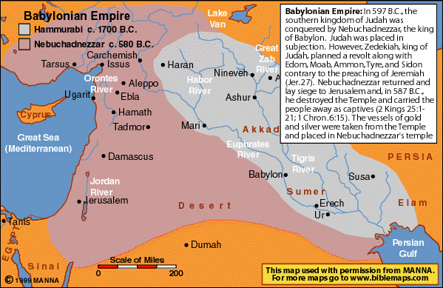

Slide 3
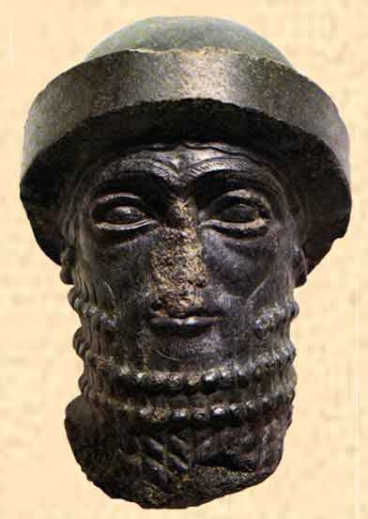
Who is
Hammurabi?

Slide 4
Hammurabi’s Code of Law
Babylonian Empire [2000 BC – 1680 BC]
Nomadic warriors overtook the Sumerians.
Hammurabi’s Code
In 1790 BC, king wrote the world’s first large collection of laws.
Legal Principles of Hammurabi
“An eye for an eye, a tooth for a tooth.”
282 specific laws.
Punishments would be based upon social class of lawbreaker.
Wealthy citizens would pay fines, commoners would face physical punishment.
Government had a responsibility for what occurred in society.

Slide 5
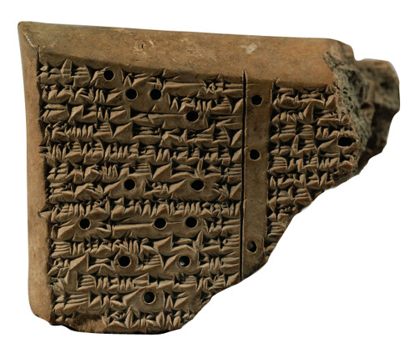
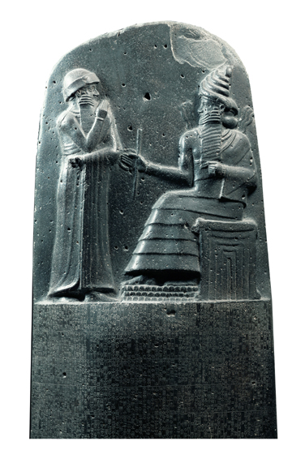
HAMMURABI’S CODE STELE VIDEO

Slide 6
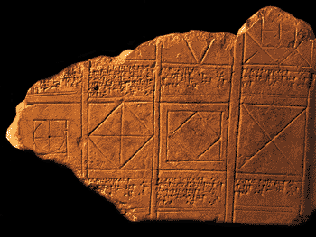

Slide 7
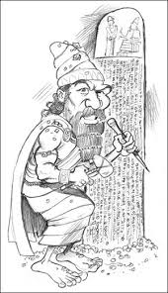
Look at me, I’m Hammurabi!!
(no, really….click the pic, it’s a video)

Slide 8
If a freeman brings false testimony in a case that carries the death sentence, he shall be put to death.

Slide 9
If a builder builds a house and does not make the construction firm and the house collapses and causes death of the owner, that builder shall be put to death.

Slide 10
If a freeman wants to disinherit his son but the judges find the son has done no grave wrong, the father may not disinherit his son.

Slide 11
If a freeman rents a field but does not cultivate it, he shall pay the owner grain based on the yield of adjoining fields.

Slide 12
If a trader borrows money from a merchant and then denies it, and the merchant can prove this loan was made, the trader shall pay the merchant three times the amount he borrowed.

