Slide 1
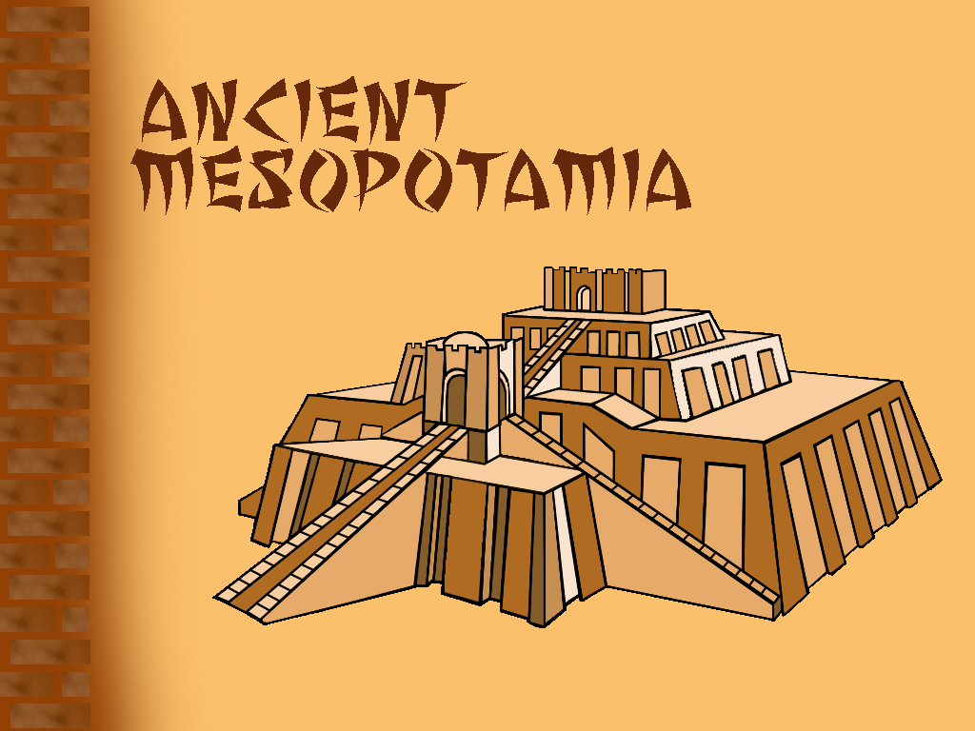
Ancient Sumer
Discovering Our Past Ancient Civilizations

Slide 2
Key Vocabulary
Anthropologist--focus on human society. They study how humans developed and how they related to one another.
Archaeologist--hunt for evidence buried in the ground where settlements might once have been. They dig up and study artifacts and other things made by humans. They also look for fossils.
Artifact--weapons, tools, and other things made by humans
Fossil--traces of plants or animals that have been preserved in rock.
History--the period of time that began after people learned to write, about 5,500 years ago.
Prehistory--the time before people developed writing.
Civilizations--are complex societies. They have cities, organized governments, art, religion, class divisions, and a writing system (8 features).

Slide 3
What Were the Ice Ages?
Paleolithic people needed fire in order to survive the Ice Ages. These were long periods of extreme cold. The last Ice Age began about 100,000 B.C. From then until about 8000 B.C., thick ice sheets covered parts of Europe, Asia, and North America. The Ice Age was a threat to human life. People risked death from the cold and also from hunger. Early humans had to adapt by changing their diet, building sturdier shelters, and using animal furs to make warm clothing. The mastery of fire helped people live in this environment.

Slide 4
Why Were River Valleys Important?
The first civilizations arose in river valleys because good farming conditions made it easy to feed large numbers of people. The rivers also provided fish and freshwater to drink, and made it easy to get from one place to another and to trade. Trade enabled goods and ideas to move from place to place. It was no accident, then, that cities grew up in these valleys and became the centers of civilizations.

Slide 5
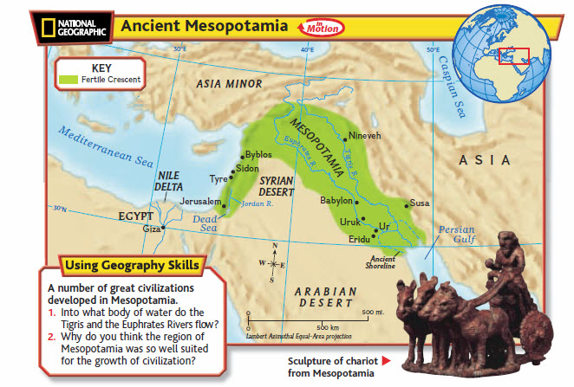

Slide 6
Early civilizations shared another feature—they had a class structure. That is, people held different ranks in society depending on what work they did and how much wealth or power they had.

Slide 7
The Rise of Sumer
The earliest-known civilization arose in what is now southern Iraq, on a flat plain bounded by the Tigris River and the Euphrates River.
Later, the Greeks called this area Mesopotamia.

Slide 8
Mesopotamia - which means “the land between the rivers.”
• Located in the eastern part of the Fertile
Crescent.
• In the spring, the rivers often flooded, leaving
behind rich soil for farming.
• Hot, dry climate.
• Known as “cradle of civilization” because of
the Sumerians ideas and inventions.
• By 3000 BCE, many cities had formed in
southern Mesopotamia in a region known as
Sumer (SOO•muhr).

Slide 9
Sumer
1. Sumerian cities were isolated from each other by geography
2. Each Sumerian city and the land around it became a separate city-
state.
3. Sumerian city-states often went to war with one another.
4. Each city-state surrounded itself with a wall for protection.
5. Believed in many gods (Polytheism). Each was thought to have power over a
natural force or a human activity—flooding, for example, or basket weaving
6. Each city-state built a grand temple called a ziggurat
(ZIH • guh • RAT) to its chief god.
7. The priests and priestesses were powerful and controlled much of
the land. They may even have ruled at one time. Later, kings ran
the government.
8. In ancient Mesopotamia, only boys from wealthy and high-ranking
families went to the edubba (the Sumerian term for "scribal school"
or “tablet house”
9. Ordinary people lived in small mud-brick houses.

Slide 10
10. Most people in Sumer farmed. Some, however, were artisans.
Other people in Sumer worked as merchants or traders. They
traveled to other cities and towns and traded tools, wheat, and
barley for copper, tin, and timber—things that Sumer did not
have.
11. People in Sumer were divided into three social classes. The
upper class included kings, priests, warriors, and government
officials. In the middle class were artisans, merchants, farmers,
and fishers. These people made up the largest group. The lower
class were enslaved people (prisoners of war., criminals, Still
others were enslaved because they had to pay off their debts)
who worked on farms or in the temples. Generally, a person had
to stay in the social class into which he or she was born.
12. Men were the head of the household. Women could buy and
sale property and run businesses.
13. Sumerians invented writing-their greatest invention. Developed
writing to keep track of business deals and other events. The
Sumerians writing was called cuneiform.
14. Invented the wagon wheel

Slide 11
15. Invented the plow, which made farming easier.
16. Invented the sailboat, which replaced muscle power
with wind power.
17. The world’s oldest known story comes from Sumer.
Epic of Gilgamesh (GIHL guh •MEHSH). The hero Gilgamesh is a king who travels around the world with a friend and performs great deeds. When his friend dies, Gilgamesh searches for a way to live forever. He learns that this is possible only for the gods.
Primary Source Document: http://www.ancienttexts.org/library/mesopotamian/gilgamesh/

Slide 12
18. Sumerians developed many mathematical ideas. They used
geometry to measure fields and put up buildings. They also
created a number system based on 60. We have them to
thank for our 60-minute hour,60-second minute, and 360-
degree circle. In addition, Sumerian people watched the skies
to learn the best times to plant crops and to hold religious
festivals. They recorded the positions of the planets and stars
and developed a 12-month calendar based on the cycles of
the moon.
19. Over time, conflicts weakened Sumer’s city-states. They
became vulnerable to attacks by outside groups such as the
Akkadians (uh•KAY• dee • uhnz) of northern Mesopotamia.
The king of the Akkadians was named Sargon (SAHR • GAHN).
In about 2340 B.C., Sargon conquered all of Mesopotamia
creating the world’s first empire. An empire (EHM•PYR) is a
group of many different lands under one ruler. Sargon’s
empire lasted for more than 200 years before falling to
invaders.

Slide 13
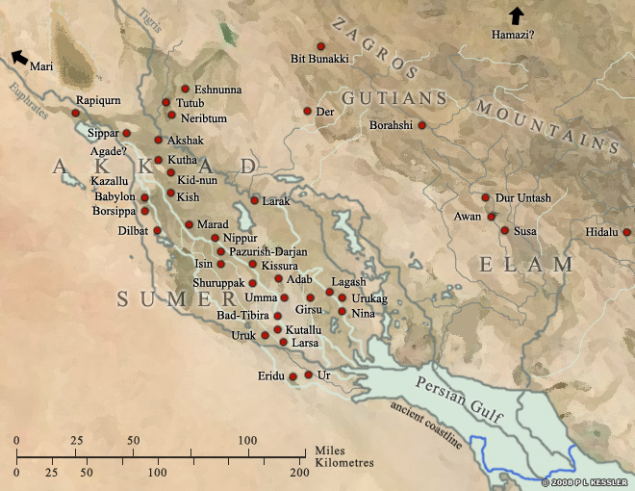
The area which formed Sumer started at the Persian Gulf and reached north to the 'neck' of Mesopotamia where the two rivers, the Tigris and the Euphrates meander much closer to each other. To the east loomed the Zagros Mountains, where scattered city states thrived on trade and learning from Sumer, and to the west was the vast expanse of the Arabian Desert.

Slide 14
The rivers have changed course considerably in the last four thousand years, moving well away from some of the cities and causing the complex network of canals to dry up, but at the time, the two rivers had separate entrances into the foreshortened Gulf.
Some of the earliest cities, such as Sippar, Borsippa and Kish in the north, and Ur, Uruk and Eridu in the south formed the endpoints of what became that complex network of cities and canals. Girsu and Nippur were highly important religious centres, but other cities, such as Larsa, Eshnunna, Babylon and Isin didn't really emerge as such until after the end of Sumerian civilization in Circa 2000 BC.

Slide 15
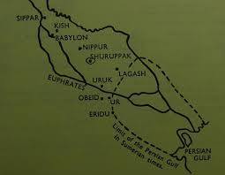
Major Cities
Ur
Babylon
Eridu

Slide 16
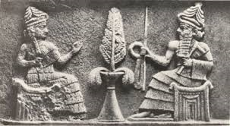
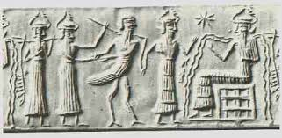
Organized Government
Ruled by kings
MONARCHY

Slide 17
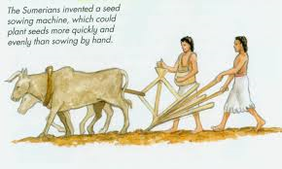
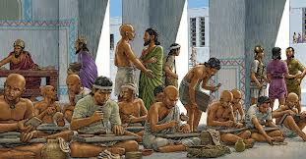
Job Specialization
Farmers
Merchants
Priests
Artisans
Scribes

Slide 18
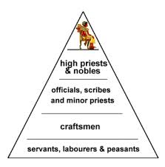
Social Class
Upper Class – Kings and priests
Middle Class – Farmers and artisans
Lower Class – Enslaved people

Slide 19
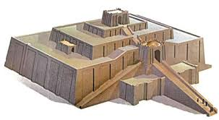
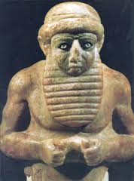
Art and Architecture
Ziggurats
Statues
Palaces
Homes
Poems
Pottery

Slide 20
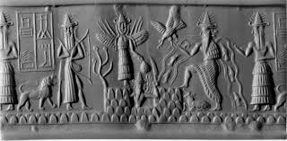
Complex Religion
Believed in many gods
Polytheistic

Slide 21
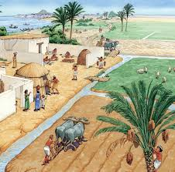
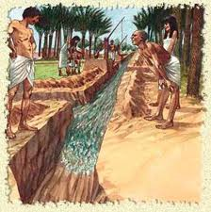
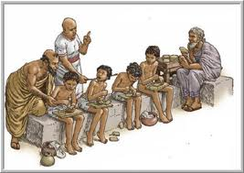
Public Works
Ziggurats
Roads
Irrigation systems
Schools for wealthy boys

Slide 22
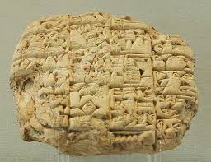
Writing
Cuneiform
Epic of Gilgamesh – first epic poem
Tablets

Slide 23
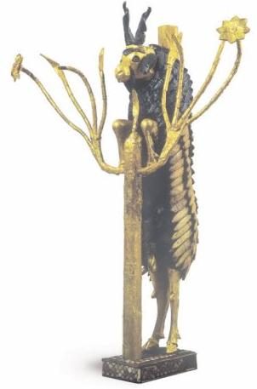
The End

