Slide 1
The Rise Of The Akkadians

Slide 2
The Rise of Akkadians
The city of Akkad was the center of the world's first empire, the Akkadian Empire. The people of Akkad, under the leadership of Sargon the Great, conquered many of the Sumerian city-states and took control of Mesopotamia. The Akkadian language took the place of Sumerian and continued to be the primary language of the region into the Babylonian and Assyrian Empires.

Slide 3
Archeologists still haven't found the city of Akkad and are unsure where it is located. It was likely located in southern Mesopotamia just east of the Tigris River.
The first Empire to rule all of Mesopotamia was the Akkadian Empire. It lasted for around 200 years from 2300 BC to 2100 BC.

Slide 4
How it Began
The Akkadians lived in northern Mesopotamia while the Sumerians lived in the south. They had a similar government and culture as the Sumerians, but spoke a different language. The government was made up of individual city-states. This was where each city had its own ruler that controlled the city and the surrounding area. Initially these city-states were not united and often warred with each other.

Slide 5
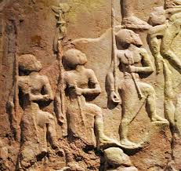
Over time, the Akkadian rulers began to see the advantage of uniting many of their cities under a single nation. They began to form alliances and work together.

Slide 6
Sargon the Great
Around 2300 BC Sargon the Great rose to power. He established his own city named Akkad. When the powerful Sumerian city of Uruk attacked his city, he fought back and eventually conquered Uruk. He then went on to conquer all of the Sumerian city-states and united northern and southern Mesopotamia under a single ruler.

Slide 7
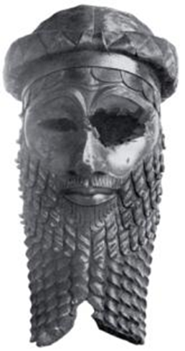
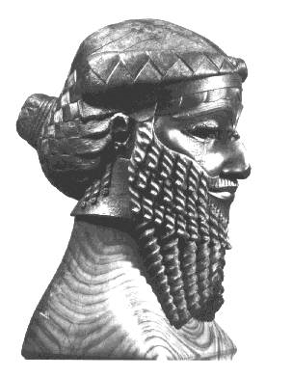
Sargon the Great (Continued)
Sargon the Great

Slide 8
The Empire Expands
Over the next two hundred years, the Akkadian Empire continued to expand. They attacked and conquered the Elamites to the east. They moved south to Oman. They even went as far west as the Mediterranean Sea and Syria.

Slide 9
Naram-Sin
One of the great kings of Akkad was Naram-Sin. He was the grandson of Sargon the Great. Naram-Sin ruled for over 50 years. He crushed revolts and expanded the empire. His reign is considered the peak of the Akkadian Empire.

Slide 10
Fall of the Empire
In 2100 BC the Sumerian city of Ur rose back into power conquering the city of Akkad. The Empire was now ruled by a Sumerian king, but was still united. The empire grew weaker, however, and was eventually conquered by the Amorites in around 2000 BC.

Slide 11
Interesting Facts About the Akkadians
• Many people in Mesopotamia at the time spoke two languages, Akkadian and Sumerian.
• There were many good roads built between the major cities. They even developed an official postal service.
• The Sumerians believed that the Akkadian Empire collapsed because of a curse placed on them when Naram-Sin conquered the city of Nippur and destroyed the temple.
• The kings maintained power by installing their sons as governors over the major cities. They also made their daughters high priestesses over the major gods.
• Sargon installed the first dynasty. He came up with the idea that a man's sons should inherit his kingdom

Slide 12
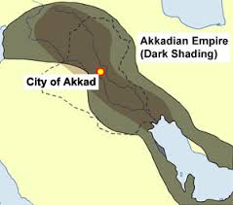
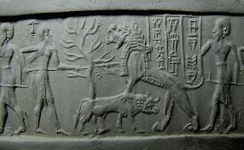
The End

